Slide 1
Marketing The Event
4.2 Licensing

Slide 2
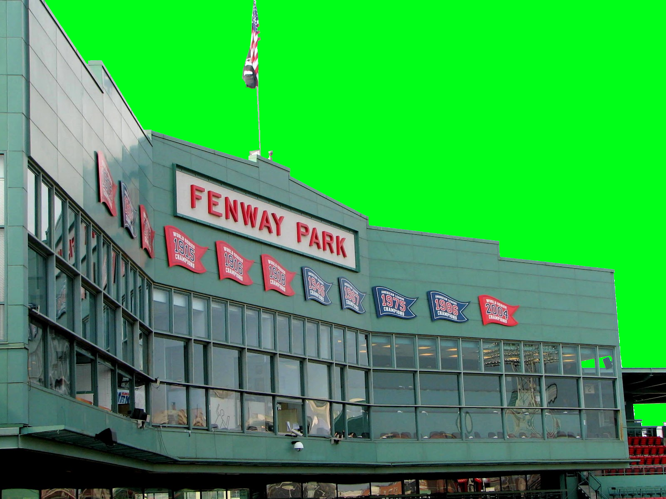
Standard Four
Students will assess the importance of event marketing & entertainment in sports.

Slide 3
Merchandising Opportunities
Licensed Products
Licensing: authorized use of a brand, brand name, brand mark, trademark, or tradename with a good or service.
Contractual Agreement
Company A uses Company B’s logo
Company A pays a ROYALTY or Fee
Booming area of sports with players, teams, event names, and logos appearing on a huge selection of products.

Slide 4
LICENSOR (Company “A”) → → → →
Company with an “official” logo in demand
EXAMPLE: Olympics
BENEFITS:
Expand into new markets
Generate more awareness for company/team
DISADVANTAGES:
Lose some control* over product mix

Slide 5
→→→→ LICENSEE (Company “B”)
The company reproducing an official logo
EXAMPLE: NIKE
BENEFITS
Positive association of products with event
Create brand awareness
Increase distribution possibilities
Charge higher prices
DISADVANTAGES
Possible negative publicity with events / athletes
Expensive

Slide 6
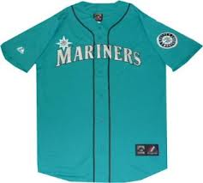
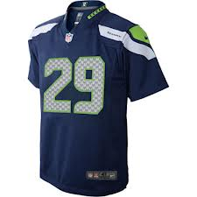
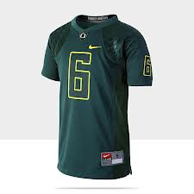
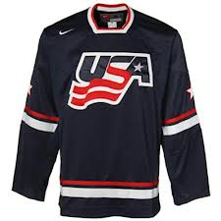
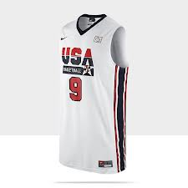
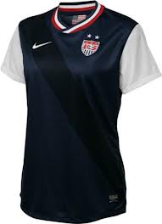
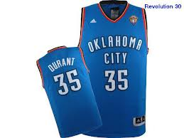
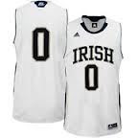
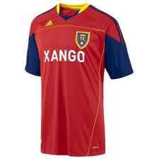

Slide 7
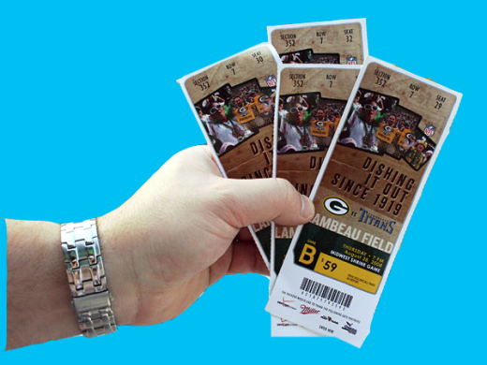
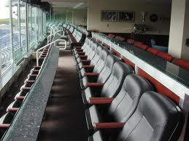
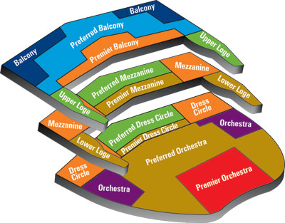
Event Seating
Personal Seat Licenses (PSL)
Licenses purchased by ticket holder which entitles that person to buy that seat’s tickets
Season Ticketing
Tickets bought for a block of games for a season
Luxury Boxes
Boxes typically purchases/leased by corporations
Variable Pricing
Setting prices based on date, time, popularity, etc.
Notes:
53
54

Slide 8
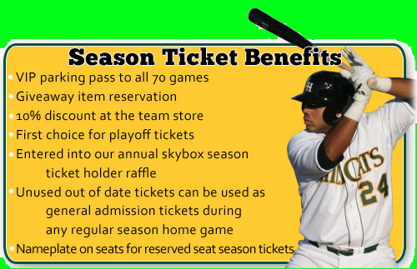
Season Ticketing
Tickets bought for a block of games for a season
May also include rights to buy tickets for other events
Ex. Concerts, shows, extreme sports, etc.
Typically better quality seats in venue
Can be bought for “nose bleed” sections
Can be bought for luxury boxes
Provides Opportunities for the venue to:
Increases sales
Increases attendance
Increases loyalty

Slide 9
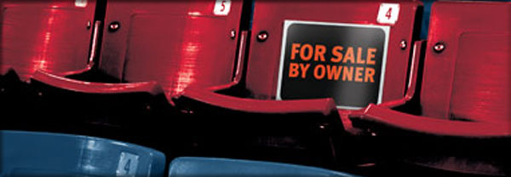
Personal Seat Licenses
A personal seat license gives the holder the right to buy season tickets for a certain seat in a stadium.
Examples & prices on Seasonticketrights.com
http://www.seasonticketrights.com/
Holder can sell the seat license to someone else if he no longer wishes to purchase season tickets. If not renewed the holder forfeits the license back to the team.
Most seat licenses are valid for as long as the team plays in the current venue.

Slide 10
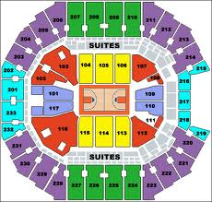
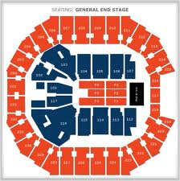
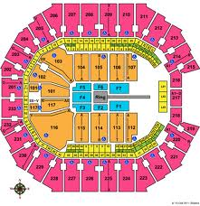
Variable Pricing
Allows events to alter pricing to maximize profit.
Can set prices based on:
Time of the year
Day of the week
Popularity of the opponent
The Charlotte Bobcats adjusted prices after the Los Angeles Clippers traded for Chris Paul and made the team’s visit more marketable.
When the Los Angeles Laker’s come to the Energy Solutions Arena to play the Utah Jazz tickets prices increase.

Slide 11
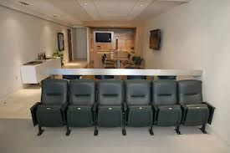
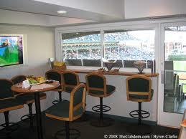
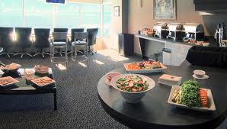
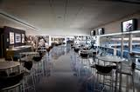
Luxury Boxes
Seating typically purchased/leased by corporations and used for business meetings and entertainment.
Provides opportunities for the venue to:
Increase Sales
High Dollar – Multi-Year Contracts
Increase Attendance
Boxes Offer additional seating
Increase Entertainment Experience
Offer more amenities for spectators
Box sales can include other opportunities
Food, Meet & Greet, Pre/Post Game Offerings…

Slide 12
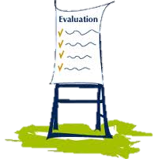
Event Marketing -- SWOT
SWOT evaluations
Used to evaluate EVERYTHING
Season Tickets
Ordering
Pricing
Delivery
Parking?
Food/Concessions?
Line-of-Sight?
Service
Security
Other Things?
Including…
Luxury Boxes
Concessions
Catering
Restrooms
Ticketing
Security @ Door
Security in Venue
In-Game Events
Audio/ P.A. System

Slide 13
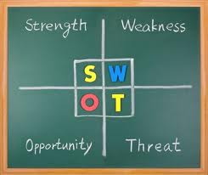
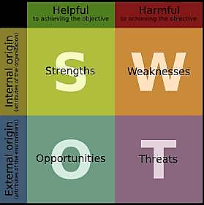
Why SWOT Evaluations
SWOT
Fast & Simple
Gives immediate feedback
Identifies Good & Bad
Allows for “Fixing”
Empowers ALL employees
Make good decisions
Implement changes
Be heard

