Slide 1
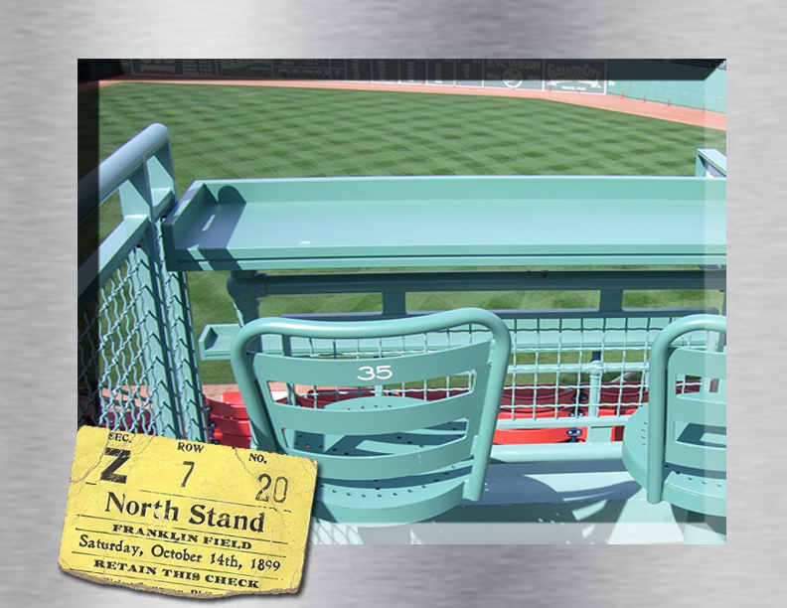
The FAN
Standard Two
Lesson 2.1

Slide 2
Introduction
Students will assess the fan’s role in sports marketing as a spectator and consumer.

Slide 3
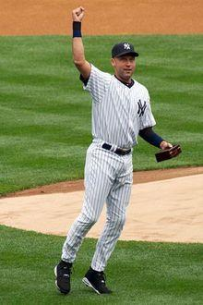

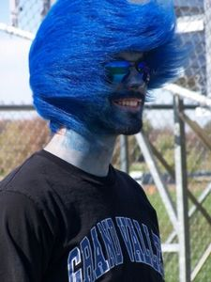
The Fan
Organized sports succeeds because of fan involvement.
  Ticket Purchases
  Merchandise Purchases
  Media Purchases
  Time Commitment
  Play & Participation
  Contest Participation
Most Sell-outs

Slide 4
Sports
Sports are a source of diversion or physical activity engaged in for pleasure
  Can be spectatorship
  Can be participation and play
Notes:
22
32

Slide 5
Sports Consumers
Consumers exchange money for a “wanted” good or service.
Sports Consumers exchange in different ways:
  Spectators as Consumers
    Benefit by watching game
    Exchange for tickets and entertainment
  Participants as Consumers
    Benefit by playing or event participating
    Exchange for equipment and participation

Slide 6
Consumer vs. customer
A Customer is the person who buys the goods or commodity and pays the price for it.
A Consumer is the user of those goods.

Slide 7

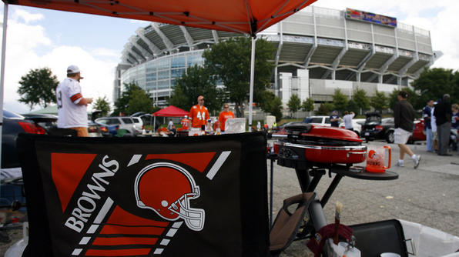
Sports Attraction
Why Do We Participate?
Personal Improvement - Better Health
Sense of Accomplishment
Develop Positive Values, etc.
Sport Appreciation
  Enjoy the game and competition
Fan Identification with the Team
Social Facilitation
  Spend time with others, feel part of a group
Notes:
24

Slide 8
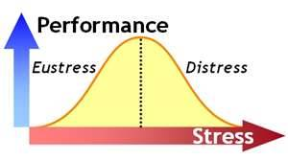
Fan Motivation
Reasons to Attend Game
Diversion from everyday life
Entertainment Value
Eustress or Positive Stress
Economic Value
Aesthetic Value
Need for Affiliation
Family Ties
Notes:
23

Slide 9
Fan Attendance Factors
What Fans Value
Reasonably Priced Parking ($8)
& Tickets ($25)
Adequate Parking/Access
Reasonably Priced Foods
Home Team With A Winning Record
Close Score
Home Team Star Regarded As
Top 10 Player
Reasonably Priced Souvenirs
Game That Ends In Less Than
Three Hours
Wide Variety Of Snack Foods
    Taken From Shank Book

Slide 10
Chart

Slide 11
Types of “Fans”
Fans | How many watched Super Bowl 2012
Audience | 111.3 million
Consumers | 70,000 in the stadium
Customers | # of People who paid (cable or ticket price)
30 sec ad costs | $4 million
Notes:
25

Slide 12
Fan = Target Market
“Fans” are typically segmented in to smaller markets by teams:
  “target markets” or “market segments”
Specific Market Segments:
  Demographic Segmentation
  Psychographic Segmentation
  Geographic Segmentation
  Behavioral Segmentation
Notes:
26

Slide 13

Market Segmentation
  Grouping consumers together based on common needs, interests, behaviors.
  Separating consumers makes measurement and promotions easier to manage
  Targeting must be:
    Sizeable
    Measurable
    Reachable
MMA Demographic:
Young, Wealthy, High-Tech

Slide 14
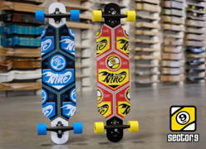
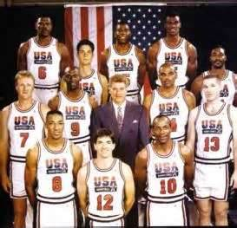
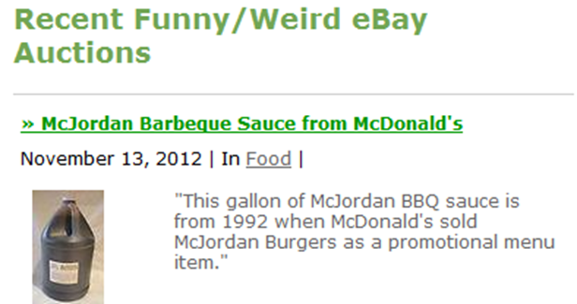


Niche Market
A relatively small part of a market that has a very special need not currently being filled is a Niche Market.
Examples
  Memorabilia Collectors & Traders
    Target Market IS Sizeable
    Target Market IS Measurable
    Target Market IS Reachable
Notes:
31

Slide 15
Demographics
  Segmentation based on measurable statistics
    Age
    Gender
    Income
    Religion
    Race
    Nationality
Notes:
29

Slide 16

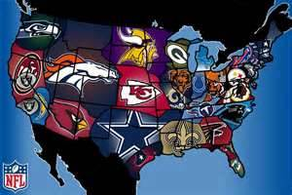
Geographics
Segmentation based on Area, Region, or Climate
  State
  County
  City
  Region
  Climate – Winter Sports, Water Sports
Notes:
30

Slide 17
Psychographics
Segmentation based on Interests & Activities
    Cheerleader
    Athlete
    Computer User
    Mini-Van Driver
    Retired Person
    Marathon Runner
Notes:
27

Slide 18
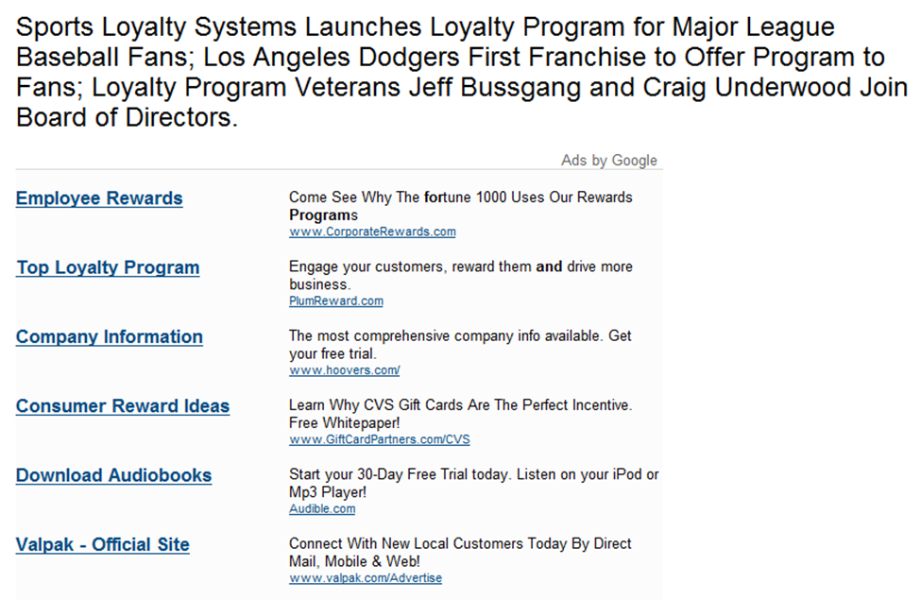
Behavioral Segmentation
  Segmentation based on
  “Rate Of Use”
    Individual is either a
    User or Non-User
      Season Ticket Holders
      Smokers
      Seat Belts
Notes:
28

Slide 19


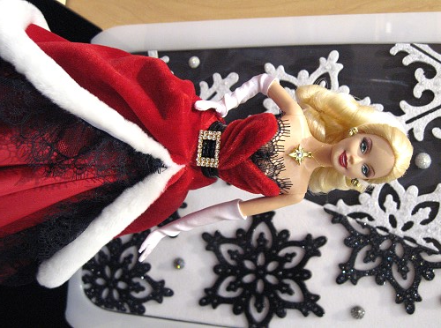
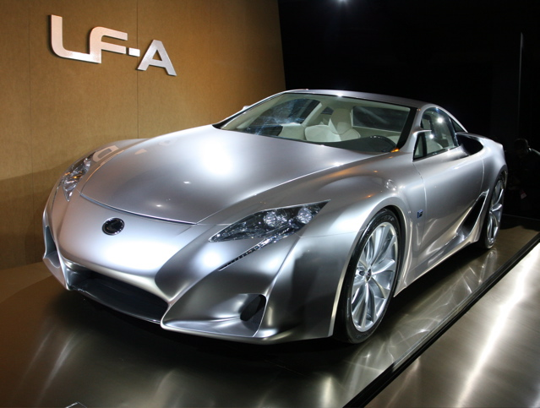
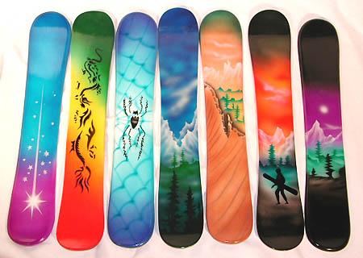

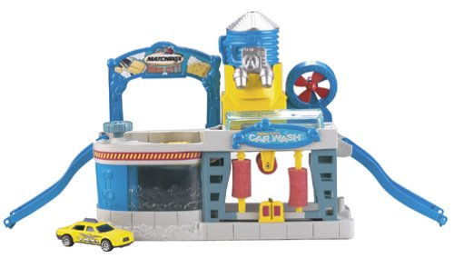

How would you segment these?
8
7
3
1
6
5
2
4

Slide 20
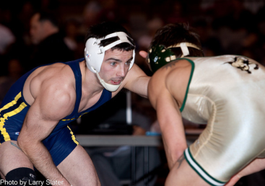

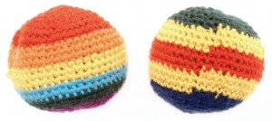
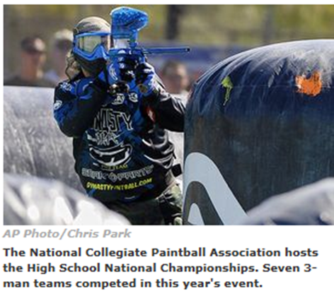
Types of Sports Participants
Participants have two classifications
  Amateur
  Professional
Sports have two classifications
  Organized
  Un-Organized
Notes:
33
34

Slide 21
Athletes
Amateur Athletes
  An athlete that is not monetarily compensated for performance
  Collegiate Athletes, Olympic Athletes
Professional Athletes
  An athlete that is compensated with money for his or her performance.
  NBA, WNBA, MLB, MLS,…
Go to college??
Make Money??
Notes:
33
34

Slide 22
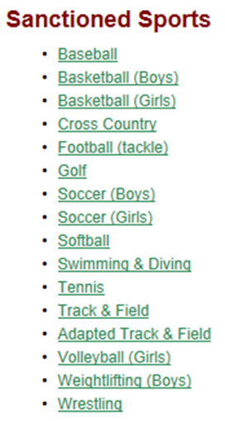
Sport Classifications
Organized Sports
  Sport that is controlled by an organizing body
  Official rules of play, participation, controlled
  “Sanctioned” Sports
  NCAA, NBA, NASCAR, NFL, Rec. Leagues
Un-Organized Sports
  Sport that is not sanctioned or controlled
  May have rules of play
Notes:
35

Slide 23
Sports Producers
Sports Producers May Provide:
  Events for Participation
  Events for Entertainment Viewing
  Sporting Goods and Equipment
  Licensed Merchandise
  Collectables and Memorabilia
  Athlete Training
  Sports Information
  Event Coverage and Distribution

