Slide 1
Entrepreneurship
Unit 3.3:
The 4 Components of the Marketing Mix

Slide 2
4 Components of Marketing Mix
Students will be able to:
Determine product brands, product mix, and inventory systems: perpetual, physical, and Just-in-Time (JIT)
Understand and calculate pricing strategies utilized to make a profit: mark-up, cost-based, competition-based, demand-based, methods of psychological pricing, discounting, and credit.
Identify the components of a promotional mix and how each will be utilized in a business.
Describe channels of distribution, and determine best methods for business.

Slide 3
The Marketing Mix
The Marketing Mix (the 4 P’s)
Product
Answers: What are you selling?
Price
Answers: How much is it?
Place
Answers: Where can I get it?
Promotion
Answers: Why should I buy it?

Slide 4
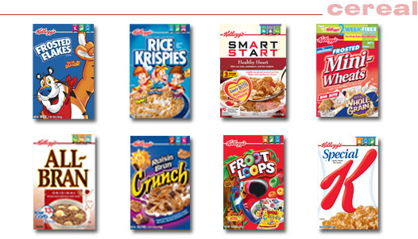
Products/Services
Product Brands
Ford, Dell, Kellogg’s
Product Mix
Categories: Cereal, fruit snacks, cookies and crackers, etc
Cereal: Frosted Flakes, Froot Loops, All Bran, etc.
Inventory methods

Slide 5
Inventory Methods
Keeping track of available stock of goods
Perpetual Inventory: Tracking inventory on a daily basis as it arrives or is sold. Computers allow “accurate” and up-to-date information.
Physical Inventory: Mistakes can be made, items are stolen or lost. Conducting a physical count of inventory is a good idea and should be done periodically to get “actual” numbers.
Just-in-Time (JIT): Suppliers ship inventory just before it’s used to keep stock at a minimum.

Slide 6
Pricing Strategies
You’re in business to make profit. Know which pricing strategies to utilize.
Mark-up
Cost-based
Competition-based
Demand-based
Psychological Pricing
Discounting
Credit

Slide 7
Cost-based Pricing Method
Utilizes Cost + Mark-up: Will you use $ or % mark-up?
Cost + $ MU = Price
($500 sofa + $300 MU = $800)
(Method best used for services, high price/luxury items; i.e. cars, furniture, accountants)
Cost + % MU = Price
($50 muffler + 60% MU = $80)
$50 x .60 = $30
$50 + $30 = $80
(Method best used if offer a lot of different products/services and everything is marked-up the same; i.e., convenience stores, auto part stores)

Slide 8
Competition-based Pricing Method
Competition-based: Lower or raise price of products/services based on what the competition is doing.
If Burger King offers Whopper for $1, McDonalds changes price of Big Mac to $1.
Retailers employ people whose job is to check competitor pricing, so they can stay in-line or offer lower prices.
Some retailers will offer coupon matching

Slide 9
Demand-based Pricing Method
Demand-based: Price is raised or lowered based on supply and demand.
Tickle Me Elmo sold for $1,000 (and up) the Christmas it was introduced. This was due to higher-than-anticipated demand and limited stock.

Slide 10
Psychological Pricing Methods
Prestige Pricing:
Denotes status
Odd/Even Pricing:
Odd numbers suggest bargains ($19.99);
Even numbers suggest higher quality ($20).
Price Lining:
Pricing items in low, moderate, and high-priced categories.

Slide 11
Psychological Pricing Methods - cont’d.
Promotional Pricing:
Lower prices offered for a limited time to stimulate sales
Multiple-unit Pricing:
Items priced in multiples to suggest a bargain and to increase volume sales (3 for $1)
Bundle Pricing:
Bundling several complementary products together and selling them for a lower combined-price

Slide 12
Discount Pricing Methods
Discount Pricing offers customers reductions from the regular price.
Cash discounts
Given for prompt payment
(2/10, n/30)→A 2% cash discount if invoice paid in 10 days. Otherwise, entire amount is due within 30 days of invoice date.
Quantity discounts
The larger the order, the cheaper the per-unit price.
1-1,000 units = $5 each
1,001-5,000 units = $4 each
5,001 + units = $3 each

Slide 13
Discount Pricing Methods cont’d.
Trade discounts
Given to distribution channel members who provide marketing functions.
Promotional discounts
Given to wholesalers & retailers for carrying-out manufacturer promotions. May be in cash or promotional materials supplied by manufacturer.
Seasonal discounts
Given to customers who buy seasonal items in the off-season. (i.e., heavy coats in middle of summer)

Slide 14
Credit
Credit: Allows customers to obtain products or services with the promise to pay later.
Buying “On Account”
Take the chance of late payments or defaulting
Use of credit cards
Costs business money in service fees to accept credit cards

Slide 15
Channels of Distribution (Place)
The path a product takes from producer to final user (consumer)
Direct
Indirect (intermediaries)
Use if results in lower cost than you would charge if you were handling all the phases of distribution yourself or if middle men have a “ready-made” network for wider distribution.
Includes transportation, storage & product handling

Slide 16
Promotional Mix
Advertising:
Paid non-personal presentation of ideas directed toward a mass audience.
Publicity:
Free placement of newsworthy items about company, etc. in the media.
Personal Selling:
Giving an oral presentation to one or more potential buyers.
Promotions:
Use of incentives or interest-building activities to create demand. Be creative!!

Slide 17
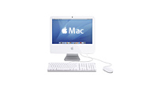
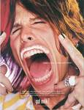
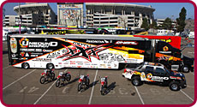
Advertising
Broadcast (TV, radio)
Print (Magazines, newspaper, catalogs)
• Outdoor & Transit (Billboards, bus)
• Internet (Banner ads)

Slide 18
Publicity
News releases (aka press releases)
Feature articles
Press conference ⇒
Seek interviews
Public relations: Any activity
that creates goodwill for a business

Slide 19
Personal Selling

Slide 20
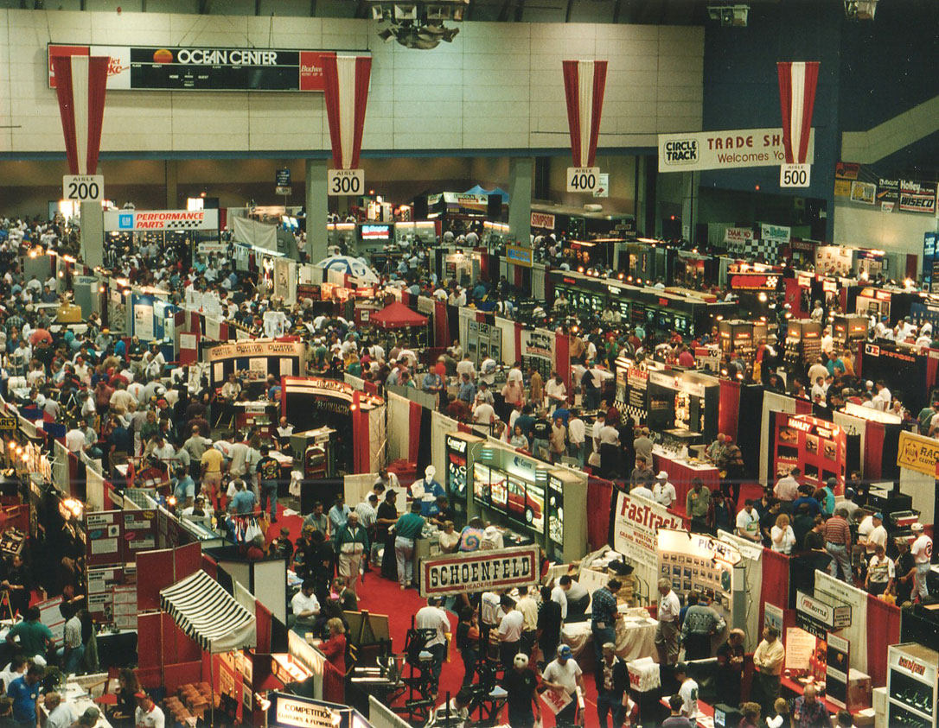
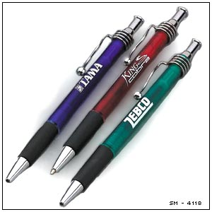
Promotions
Incentives
Displays/Tradeshows
Premiums
Rebates
Samples
Sweepstakes/Contests
Sponsorships
The sky’s the limit!

Slide 21
4 Components of Marketing Mix
Let’s Review:
Determine product brands, product mix, and inventory systems: perpetual, physical, and Just-in-Time (JIT)
Understand and calculate pricing strategies utilized to make a profit: mark-up, cost-based, competition-based, demand-based, methods of psychological pricing, discounting, and credit.
Identify the components of a promotional mix and how each will be utilized in a business.
Describe channels of distribution, and determine best methods for business.

