Slide 1
Sports Marketing
Standard 1.4
The
Event Triangle

Slide 2
Objective Four
Compare components of the event triangle and summarize exchanges for each

Slide 3
Event Triangle
The model for studying the exchanges developed in Sports Marketing is formatted as an Event Triangle.
The Event Triangle emphasizes the relationships between producers and consumers in the sports marketing model.

Slide 4
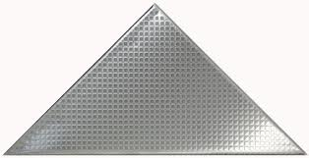
Event Triangle
Components of the Triangle:
event
fan
sponsor
Notes:
14

Slide 5
The “Event”
The Event is the sporting event which will draw participants, spectators and sponsors.
The Event can be amateur or professional.
The Event may provide entertainment.
The Event may provide an opportunity for exposure for sponsors.

Slide 6
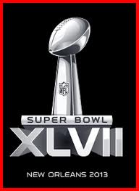
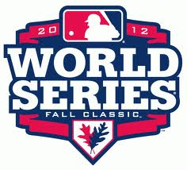
Examples of Events
Superbowl
NCAA “March Maddness”
World Series
UHSAA State Playoffs
Junior Jazz Championship Tournament
Your High School’s Homecoming & Dance

Slide 7
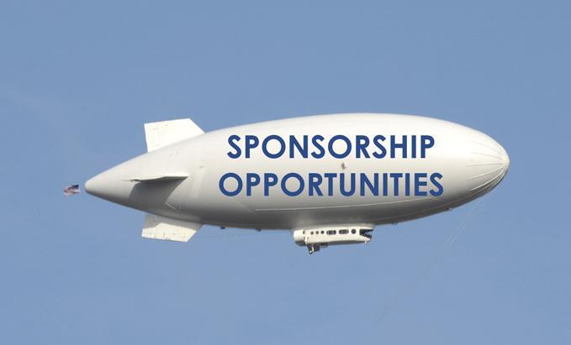
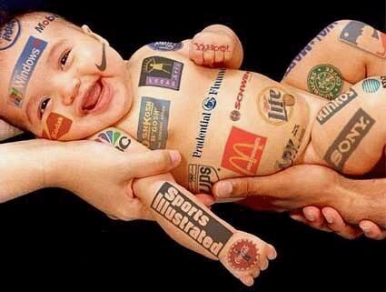
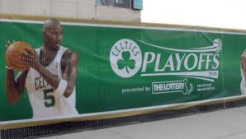
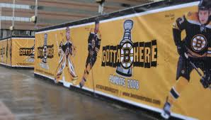
The “Sponsor”
The Sponsor can use the Event to reach important consumers for the company.
The Sponsors can utilize the draw of the Event to market its products or services.
The Sponsor can leverage its relationship to further business opportunities.

Slide 8
The “Fan”
The Fan typically attends the Event as a source of entertainment.
The Fan usually pays to attend the Event.
The Fan may be exposed to promotions for the event and event sponsors.

Slide 9
The Fan’s Role in Sports
Fan = “Fanatic”
Someone who is interested, involved and engaged in the event.
Football, Basketball, Baseball, Golf
Fan is the reason for Sports Marketing
IS the power behind success of sports
IS the economic force
SHAPES the game with attention

Slide 10
Exchanges in the Triangle 1
Event ← → Fan Exchanges
Fan: money
Event: entertainment, merchandise, …
EVENT
exchange
FAN
SPONSOR
Notes:
15
17

Slide 11
Exchanges in the Triangle 2
Event ← → Sponsor Exchanges
Sponsor: money, products, services,…
Event: exposure, promotion, sales opportunities
EVENT
exchange
FAN
SPONSOR
Notes:
16
18
19

Slide 12
Exchanges in the Triangle 3
Sponsor ← → Fan Exchanges
Fan: money
Sponsor: products or services
EVENT
exchange
FAN
SPONSOR
Notes:
17

Slide 13
Event Marketing Concerns
Draw
Promotion
Sales Opportunities
Ambush Tactics
Notes:
20

Slide 14
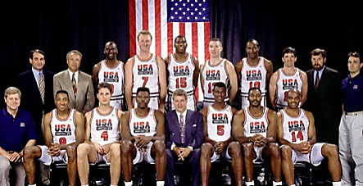
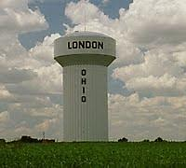
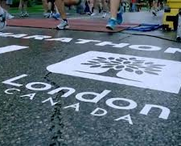
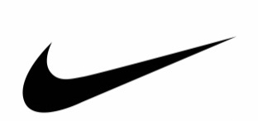
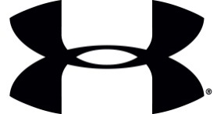
Ambush Tactics
Marketing strategy where the advertisers associate themselves with a particular event without paying any sponsorship fee
Nike, not an official Olympic sponsor, had a YouTube ad that promoted athletes in towns around the world named “London.” They didn’t actually say the 2012 London Olympics, but subliminally and emotionally implied it.

Slide 15
Effects of Media Broadcasting on the Event Triangle
Expansion of the target market
Expansion of marketing opportunities
Expansion of distribution & consumption of the event
Examples: Cable, Satellite, Pay-Per-View
Notes:
38

Slide 16
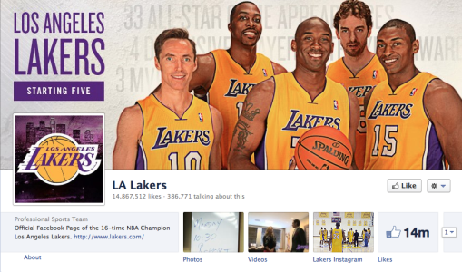
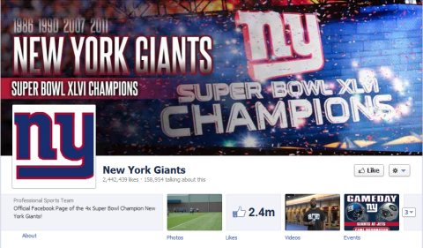
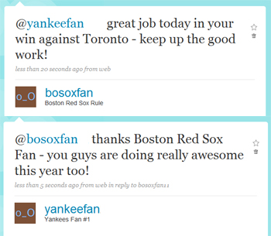
Effects of Social Media on the Event Triangle
Social media isn’t about technology, it’s about fans
Build online fan communities to allow them to connect with one another, and in turn – to the team
Leverage community numbers to make money through e-commerce
Sponsorship opportunities present themselves by increasing visits to team sites

Slide 17
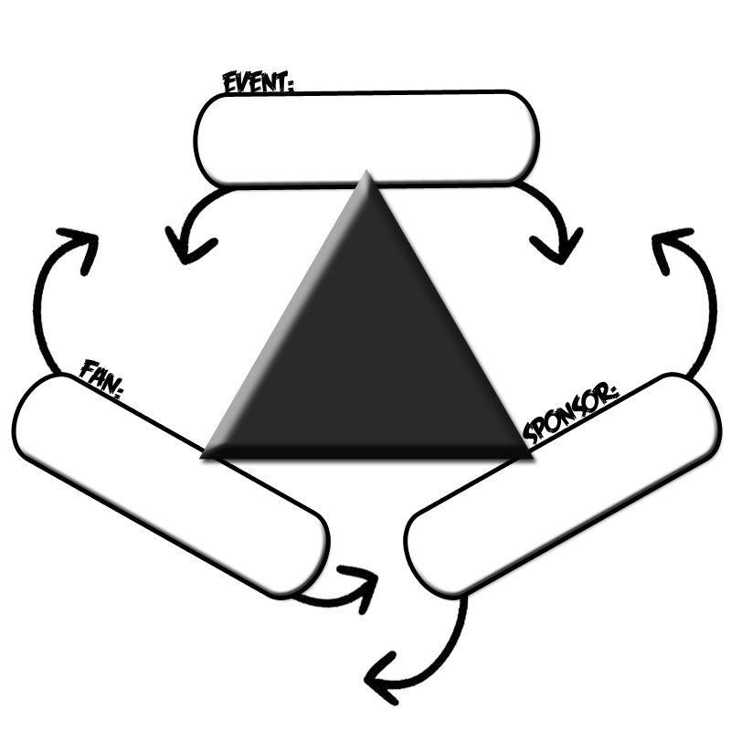
Your Turn…
On your paper, explain/describe the event triangle & exchanges for three events of your choice. Be Specific!
$
$$
Game entertainment
Venue sponsorship & sales opportunities
Me
$$
Purchase coke drink at game

